Slide 1

DRT/MAT* as it Relates
to NA
Helping Members Take Root
*Drug Replacement Therapy/ Medication-Assisted Treatment
Notes:
PETRA Welcome! Introduction

Slide 2
3
TRADITION THREE
The only requirement for membership is a desire to stop using.
TRADITION
Notes:
ALON: We´re here for the addict that isnt born yet, our vision…
Member reads
It is important to remember our primary purpose so that addicts who come to their first meeting can relate and identify with others at the meeting.
Goal and purpose of this workshop:
• To consider how to carry our message of hope and freedom in a changing environment
• To begin thinking about how people come to identify as members and what helps them stay
• To help people “take root” and establish themselves as members of NA.

Slide 3


Our Third Tradition offers relief from reservations we
might have about membership and
about each other.
Guiding Principles,
“Tradition Three”
Notes:
Member reads

Slide 4
“The group is not the jury of desire…. No addict should be denied an opportunity to stay long enough to develop that desire. We can nurture that desire with loving acceptance.”
“…we are encouraged to open wide the doors of our meetings to any addict who wishes to join. We are asked to extend to others the care and concern that helped each of us find a sense of belonging.”
It Works: How and Why, Tradition Three
It Works: How and Why, Traditio
3
TRADITION
Notes:
Member reads
SAM: Share a couple of words

Slide 5
3
“Tradition Three swings the door to Narcotics Anonymous wide open and invites an opening in our own hearts. As long as we have a desire to stop using drugs, our right to membership in NA is unconditional. We may attend meetings for a long time before deciding to be members. When we make that decision, our lives begin to change.”
Guiding Principles, Tradition Three
TRADITION
Notes:
Member reads

Slide 6
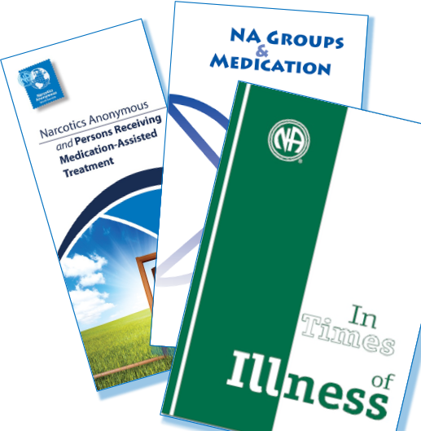
We’ve been having conversations around drug replacement therapy, or medication-assisted treatment (DRT/MAT) for decades.
It’s clear we don't have a unified Fellowship position on this issue.
Notes:
PETRA:
We’ve been having conversations around drug replacement therapy or medication assisted treatment (DRT/MAT) for decades. It’s written about the issues in In Times of Illness, NA Groups and Medication, and the PR pamphlet NA Persons Receiving Medication Assisted Treatment.
The Fellowship has been surveyed on what to say in a piece of recovery literature about the topic, and that survey made it clear that we don't have a unified Fellowship position on this issue.
Three previous Issue Discussion Topics have been at least partially devoted to the topic. Many groups still struggle with how to respond to addicts who arrive at our doors on medication assisted treatment. And so the discussion continues.

Slide 7
It’s important to talk about because…
It is not going away
Medication is frequently part of treatment and may be mandated for compliance
We need to consider how to carry the message in the world we live in
Notes:
PETRA
It’s important that we have these conversations because:
• It’s not going away.
• Medication is part of treatment in and out of corrections, more and more of the time.
• Many people who come to the DRT/MAT program are sent here because they have to, and they might also have to take medicine as part of their agreement.
• Whatever our individual feelings are about this subject, we exist in a larger world and its approach to addiction has changed. We need to consider how we carry the message in the world we live in, not the world we might wish for.
And professionals choose not to refer addicts on DRT/MAT to NA.

Slide 8

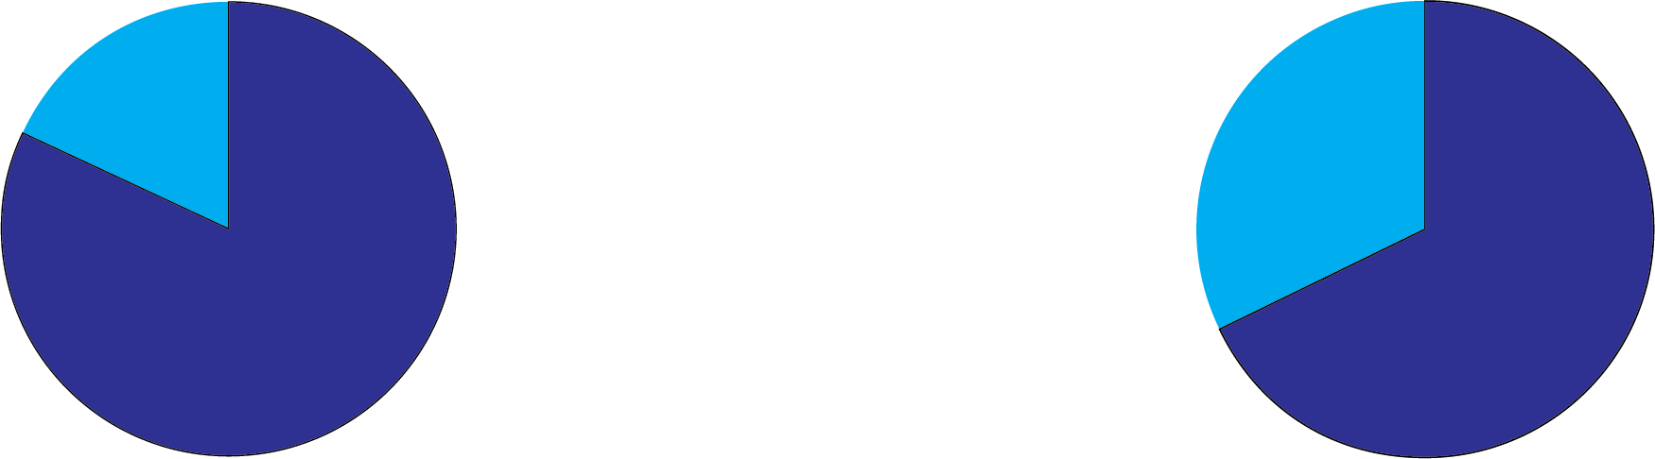
It is our job to make sure that recovery is available to anyone who wants it, and that it is attractive to those who need it.
If professionals are unwilling to refer people to NA, some addicts may never find us.
Most recent membership survey
82%
stayed in NA because of identification with other members
68%
said their first meeting was important or very important
Notes:
LENA:
How do we build a common bond when almost every door to NA has medication built into its frame? For many people outside NA, the lie is not dead: there is a prevailing belief that the only hope for the addict is long term treatment with medication. As an organization we don’t endorse or oppose other approaches to recovery – even when it’s tempting. That means we set aside any feelings we may have about the treatment industry when welcoming the newcomer. This workshop isn’t about focusing on entities outside of NA; it’s about actively encouraging a dialogue about how we can further our primary purpose. It is our job to make sure that recovery is available to anyone who wants it, and that it is attractive to those who need it.
The reality is NA’s reputation affects our ability to carry the message. Most of our members first find NA through treatment or drug courts. If professionals are unwilling to refer people to NA, some addicts may never find us. No matter how people find NA, what makes them stay seems clear. Our most recent membership survey said that 82% stayed in NA because of identification with other members, and 68% said their first meeting was important or very important. This session is about building on those strengths and helping people to find a sense of belonging and take root in NA.

Slide 9

Where we have consensus as a Fellowship
Our message is hope and the promise of freedom.
We are a program of complete abstinence.
It doesn’t matter what or how much you used.
What we care about is what you want to do about your problem and how we can help.
The only requirement for membership is a desire
to stop using.
We want people to be able to choose
NA membership no matter how they get here.
We want NA to be a safe place to recover.
Notes:
ALON:
Where we have consensus as a Fellowship:
• Our message is hope and the promise of freedom. We are a program of complete abstinence.
• It doesn’t matter what or how much you used.
• What we care about is what you want to do about your problem and how we can help. • The only requirement for membership is a desire to stop using.
• We want people to be able to choose NA membership no matter how they get here.
• We want NA to be a safe place to recover.

Slide 10

Is there anyone here who has experience coming into NA on medication to treat addiction and now living drug free?
Would you be willing to share a few thoughts
on your experience?
Notes:
SAM:
Is there anyone here who has experience coming into NA on medication to treat addiction and now living drug free? Would you be willing to share a few thoughts on your experience – 5 minutes or less? [Facilitators may want to identify someone who can share their experience before beginning the workshop]
(If not, we can read the story “The Only Requirement” pp 184-187 in the Basic Text)
Thank you so much for your share. As we move into discussion, we want to remember the many stories like {name}; we are talking about real people struggling to get clean.

Slide 11

Small Group Discussion
Facilitators Guidelines:​
​
Choose someone to take notes.​
Remind the group of their task and time limit.​
Make sure everyone gets to share their thoughts.​
Help the group summarize the main points to share with everyone.​
Notes:
As we move into small groups, we are going to talk about……
Each group should select a facilitator who can ensure that everyone gets a chance to share.

Slide 12
Small Group Discussion
QUESTIONS # 1
As a program of complete abstinence, how do we help people feel included enough to be able to choose whether to be an NA member?
How can people who are taking drt/mat take part in NA service?

Slide 13
Small Group Discussion
QUESTIONS # 2
What does it mean to move from being “someone who goes to some meetings sometimes” to being a member of NA?
How can we help people that are on drt/mat to keep coming back?

Slide 14
Small Group Discussion
QUESTIONS # 3
What to answer if a person coming to meetings on drt/mat asks: am I clean?
How can we set aside some of our own fear and judgment about members who come in on DRT/MAT to focus on helping addicts find a home in NA?

Slide 15

Large Group Discussion
What is one thing that was shared that stood out for you in the small group discussion?
Notes:
Ask facilitator

Slide 16
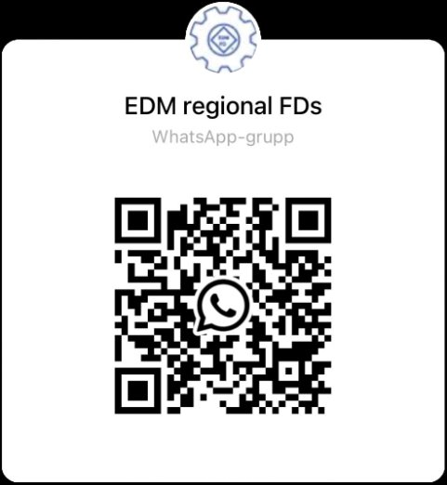
Thank you for your participation!​
​EDM FD ​
fd@edmna.org​
​
​
If you want to join to the EDM FD​
WhatsApp Group, please use the QR code!​
All workshop material is available at edmna.org

