Slide 1

Step 11 Workshop

Slide 2
Step 11 Workshop

Slide 3
"We sought through prayer and meditation to improve our conscious contact with God as we understood Him, praying only for knowledge of His will for us and the power to carry that out."

Slide 4
We try through inward dialogue and meditation to receive more inner contact with the healthy part of our will. We are trying to figure out where this healthy part wants to go, and we try to be guided by this.

Slide 5

Finding our own spiritual path
Trying to figure out where the healthy part of our will wants to go

Slide 6
Finding our own spiritual path
We've developed a frame of reference about spirituality in the previous ten steps - a path out of active addiction.
Our insight has grown along with our capacity to find personal truth and comprehend new information about ourselves and our world.
We can look wherever we want for our spirituality, for knowledge and awareness, without threatening our membership in NA.
It's up to each member.

Slide 7
„We're also likely to read a great number of books
concerned with spirituality and personal growth,
and talk to a great number of people.“

Slide 8
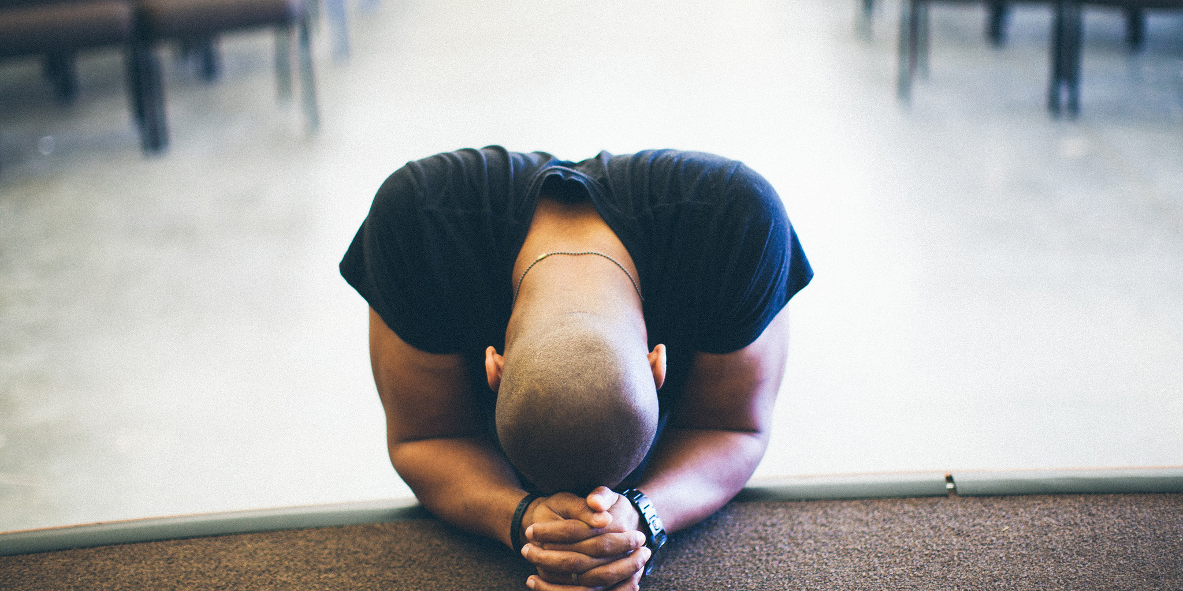
Prayer
Step 11

Slide 9
Prayer
Prayer is talking to our Higher Power, though not always in the form of actual speech.
One of the forms of prayer in which virtually every NA member engages is the closing or opening prayer said at most NA meetings.
Ultimately, the manner in which we pray is up to us as individuals.

Slide 10

Meditation
Step 11

Slide 11
Meditation
We've already been meditating, and doing so on a regular basis. Each time we stand as a community at a meeting and observe a moment of silence, we are meditating.
There are many different ways we can go about meditating, but its usual goal is to quiet the mind so that we can gain understanding and knowledge from our Higher Power.

Slide 12
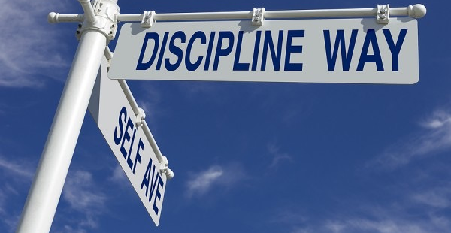
The power to carry that out
Discipline helps to turn a habit into a need.

Slide 13
Moving On:
We don’t forget about things, but we accept what happens and continue living.“

Slide 14
Speaker
... from …

Slide 15

Small Group Discussion
Listening
Sharing our thoughts and experience
without judging
Prayer and Meditation

Slide 16
Small Group Discussion
Choose your table.
We start together with the serenity prayer.
Take 10 Min. of silence to meditate about what kind of experience you have.
Choose a facilitator.
Choose a member to collect notes on a sheet of paper.
Compile the relevant notes to the flip chart.

Slide 17
Table: Prayer
What does prayer mean to you?
How do you pray?
What is the effect of prayer in your life?

Slide 18
Table: Meditation
What does meditation mean to you?
How do you meditate?
What is the effect of meditation in your life?

Slide 19
European Delegates Meeting
www.EDMNA.org
© Copyright 2016 by Narcotics Anonymous

