Slide 1
PUBLIC RELATIONS

Slide 2
session outline
Icebreaker What is NA’s image in your local community? What are some of NA’s public image problems in your local or regional community? This Powerpoint is set as a toolbox and can be used for workshops or introduction sessions. Each module can be combined to requested needs. Module 1+2: Can be used as a single Workshop to introduce PR Basics to members who are not familiar with PR. Module 3+4: Is addressed primarily to those, who consider being involved in PR Committee service.
Module 1: PR Basics
PI vs. PR
Goals and Principles
PR and the Public
Module 2: Tradition Scenarios
Our Traditions and Values
Small Group Discussion
Experience
Module 3: The PR Committee
How to Start
Planning
Resources
Module 4: The PR Presentation
Preparation
Giving a PR Talk
FAQ at PR Presentations
INTRODUCTION

Slide 3
Module 1: PUBLIC RELATIONS BASICS PI vs. PR Goals and Principles PR and the Public
Module 3: THE PR COMMITTEE How to Start Panning Resources
Module 2: TRADITION SCENARIOS Our Traditions and Values Small Group Discussion Experience
Module 4: THE PR PRESENTATION Preparation Giving a PR Talk FAQ at PR Presentations

Slide 4
Module 1: PUBLIC RELATIONS BASICS PI vs. PR Goals and Principles PR and the Public

Slide 5
public Relations statement
The NA message is “that an addict, any addict, can stop using drugs, lose the desire to use and find a new way to live.”
Our relations with the public enable us to share this message broadly so that those who might benefit from our program of recovery can find us.
We perform public relations service to increase the awareness and credibility of the NA program.
The spiritual principles of our steps, traditions, and concepts guide us in pursuing our public relations aims.
PR BASICS

Slide 6
Large group discussion
What is NA’s image in your local community?
What are some of NA’s public image problems in your local or regional community?
Why is it important to improve Public Relations? >>>
PR BASICS

Slide 7
public Relations tradition 11
Our public relations policy is based on attraction rather than promotion; we need always maintain personal anonymity at the level of press, radio, and films. - and internet.
NA is meant to have a public relations policy.
We provide information about our program.
We engage in meaningful relationships with others (who have similar goals).
We can grow by taking on a more active role in our relationships with members of the public.
We can provide PR services less reactive and more proactive.
PR BASICS
Notes:
NA is meant to have a public relations policy.
It means that we fulfill our responsibility to provide information about our program and engage in meaningful relationships with others who have similar goals.
We can grow by taking on a more active role in our relationships with members of the public.

Slide 8
public Relations Tradition 5
PR is a crucial part of our primary purpose “to carry the message to the addict who still suffers” because it let’s prospective members and those who seek to help them know who we are and where to find us.
Without newcomers, the most important people in our meetings are absent.
NA cannot help addicts if they never hear of us, or if our reputation is such that addicts are advised to steer clear of us.
NA will reach some addicts directly, good community relations or not. (members invite friends, family members, coworkers, etc.)
However, most addicts must be reached indirectly through others in the community (media reports/announcements, professional refferral, ...)
PR BASICS

Slide 9
What is Public INFORMATION?
Public information service in NA has naturally evolved
In the recent past, our program was relatively unknown. Initially, the focus of our PI efforts was on informing the public of the existence and purpose of our program.
As we have grown as a fellowship and developed services, we have recognized the increasing need for public awareness in order to reach the still suffering addict.
PI had a history of no (communication) follow-up.
PR BASICS

Slide 10
What is Public Relation?
PR is a process: Simply the building and maintaining of relationships with people and organizations outside NA.
PR is just another way of saying: Taking care of our relationships. They will change and grow over time.
ALL the relationships that we create and maintain are PR.
Many communities have renamed their committees “public relations,” which fosters the building and maintaining of relationships with the public.
PR needs good communication: Listening, Following Up, Responding. It needs more than just the words which comes out of our mouth.
PR BASICS
Notes:
PR needs good communication: Listening, Following Up, Responding. (it needs more than just the words which comes out of our mouth)
like in a relationship (attachemnet and intimacy: listening, not judging, sharing thoughts and feelings)

Slide 11
public Relations the ways we provide information
Public Relations helps addicts to find NA.
Distributing PR material: posters, billboards, fliers, and other public service announcements to inform the public of how to reach us.
Providing website information, meeting directories, informational letters, and pamphlets to people who may come in contact with addicts.
Holding community Learning Days and workshops to educate and train our members.
Responding to requests for presentations, attending exhibits and providing booths at conferences/health fares to reach out to pros who work with addicts.
Phonelines !!!
PR BASICS
Notes:
Cooperating with the H&I and phone line committees in overlapping projects.
Where a separate phone line committee does not exist, a PI committee may be responsible for operating a phone line.
Our ability to effectively carry the NA message greatly depends on strong local phoneline services. A strong local phoneline helps us help addicts. Our phonelines are an opportunity to form cooperative relationships that may benefit potential NA members.

Slide 12
Who Is “The Public”?
Potential new members! Na Members! (Internal Public: one of the greatest influence in attracting new members) Those that are close to or influence the lives of addicts:
Treatment Facility Staff
Health Care Facilities / Social Service Facilities (f.e. Job Center)
Medical professionals
Prison Officers / Parole Officers
Health Fairs / Addiction Conferences
Family members
High Schools / Universities (Social Worker / Physicians)
Internet / Social Media
PR BASICS
Notes:
They have seen the program work for someone they know.
EU more recovering addicts
Treatment Centers

Slide 13
public Relations UNITY
It is through the unity of members in their service efforts, and a cooperative attitude toward the public that helps the NA message of recovery to grow.
Our common welfare – the good of NA as a whole - must be at the forefront of our consideration.
Unity does not equal uniformity. Creative action of the spirit takes many shapes and forms throughout our Fellowship.
Thinking about principles before acting is never a mistake, but we can get lost in policy and procedure and not get very much done at all.
Our actions in forming relationships with the public can have a profound effect on whether or not addicts can find NA.
PR BASICS

Slide 14
public Relations Goals
1. We clarify what services NA can and cannot provide to the community.
NA offers a safe place for addicts where members learn from one another how to live drug-free and recover from the effects of addiction in their lives. NA doesn’t offer: Social Work, Housing, Jobs, Counceling, Dating Platforms.
2. We make NA members more aware of their role in NA’s public image.
Newer members see how we behave and make choices about our fellowship. They may also share their views with their PO’s and others. Do we share our views on outside issues as if they were the views of NA?
PR BASICS
Notes:
GOAL 1
What NA can provide:
Mutual support, self help, 12 Step Meetings
24 hr. helpline w/meeting & event info.
Direct friends/family to other services
Refer callers to 211 for non-NA services
Web pages with current meeting, event, and contact information.
PR presentations to public organizations
Placement of IP racks in public places
H&I meetings in facilities
What NA can not provide:
Telephone counseling or advice to family
Referrals to detox or treatment centers
Opinions about using addicts’ behaviors.
Information about the effects of drugs.
Opinions about drugs, drug laws or other outside issues.
Links to non-NA pages
Suicide prevention advice!
Housing and job referrals.
GOAL 2
Provide an atmosphere of recovery in our meetings
Exemplify positive behavior in our personal conduct
Make members aware of service opportunities in an attractive way.
Maintain excellent relationships with facilities by having positive behaviors
Remember that these relationships is essential to the survival of NA in that area
Leave facilities clean inside and outside including cigarette butts
Each member is responsible for acting in a way that reflects positively on NA
Relationships with these facilities is the foundations for our overall community relations efforts
Remember that how we behave while wearing NA logos reflects on NA’s image
Loud music, loud motorcycles, public profanity, suggestive or lewd comments and rude behavior does not make us more welcome in the community

Slide 15
public Relations Goals
3. We aim for the public to recognize NA as a positive and reliable organization.
The public does not necessarily recognize addicts as positive and reliable members of their community. The way we communicate with the public has an effect of how the public refers to NA as an reliable and safe ressource.
4. We develop valuable relationships with professionals and the general public.
Our communication should be informative and should directly address any misconception the public may have. Our relationships will change and grow over time.
PR BASICS
Notes:
GOAL 3
Consistent information about NA must be available by internet, phone and in print.
It should not be difficult for those who wish to refer addicts to NA to find our meetings and services
We should question any practices that do not protect the anonymity of our members; we do not identify addicts who are our members or expose their personal stories and information
GOAL 4
Making our service positions the points of contact consistently over the long term
Honor anonymity and the 12 Traditions
Utilize e-mail addresses that belong to the NA domain name from your area or region.
Use commonly understood language rather than what we describe in the Fellowship as a “Clear NA Message.”
Always meet with the public with at least one other addict trained in Public Relations
Read the Public Relations Handbook completely and learn the core values described in each chapter.
Keep in regular contact with the organizations with which we have created relationships

Slide 16
Spiritual Principles of PR in Action!
BE RESPECTFUL - We show respect to earn respect
We share information with outside groups and community organizations about NA’s program of recovery and our traditions.
We also take the time to learn about the goals, language, and values of the organizations we are working with to create a more successful interaction.
BE TRUSTWORTHY - We keep our word
We act with integrity and honesty that allow our partners in the community to rely on our clear, consistent message and reliable actions.
PR BASICS

Slide 17
Spiritual Principles of PR in Action!
BE FLEXIBLE - We work with them, not against them
We may need the organizations we are working with to respond to our needs with flexibility, and we can work to do the same.
We take care to listen to their requests and, while keeping in mind our underlying principles, consider whether or not we can accommodate them.
BE CONSISTENT - We keep in touch with the organization
We strive to provide accurate information and facilitate an ongoing dialogue, to let other organizations know that they can count on us.
These spiritual principles foster strong relationships among service members as well!
PR BASICS

Slide 18
Pr and the NA member
Much of the goodwill that exists between NA and the community at large is based on the relationships that we develop and maintain as NA members.
We can improve these relationships by taking care to treat others with courtesy and respect.
As a fellowship, we have no control over the behavior of individual NA members.
We can communicate to them that a bad image of NA could easily keep the message of recovery from reaching the addict who still suffers.
Na Members are one of the greatest influence in attracting new members to meetings.
PR BASICS

Slide 19
PR and the NA group
Members of NA groups can and often do perform some basic PR work to help carry the message of recovery to addicts.
Posting bulletins. Printing and distributing meeting schedules. Informing other addicts about their meetings.
Groups should always be careful not to make statements or commitments that overstep their abilities.
The need for additional services to the groups is usually met by the formation of area service committees, so that the groups are not distracted from their own primary purpose.
PR projects may cause an increase in newer members attending meetings.
Groups may need to get prepared for this influx.
PR BASICS
Notes:
An area’s public relations goals can have significant impact on the groups. Thoroughly discussing public relations projects during an area service meeting will help group service representatives communicate the area’s discussions and goals to their groups. Area projects may cause an increase in newer members attending meetings. Groups may need to prepare for this influx by developing meeting formats that better serve a large influx of new members. Successful PR projects depend on meaningful group involvement.
Group members should take the time to have step-by-step discussions about the area’s PR efforts. GSRs are the communication link between the area and groups and can bring members’ concerns or questions back to the area meeting. This link helps keep groups involved and informed. This link also provides a back-and-forth dialogue between the area and groups. Communication helps the area come together to further NA’s primary purpose.
An area‘s PR goals can have significant impact on the groups.
What can we do?
Newcomer Orientation/Workshop delivered to treatment and drug court clients.
Newcomer orientations before meetings.
Some regions with a hotline have an agreement with 3-4 meetings that they refer addicts who call the hotline to these meetings. These meetings have prepared themselves and serve as a first stop.

Slide 20
PR and the H&I Committee
Cooperation between committees is an important part of providing service in Narcotics Annymous.
We may understand our own functions well but know little of how other committees operate.
The basic difference in function. H&I panels present the program primarily to addicts. PR committee makes its presentation primarily to non-addicts.
PR and H&I committees should cooperate, if contacts were to become an opportunity for a PR presentation at the hospital, or during a presentation it occurs that participants request a H&I meeting.
PR BASICS

Slide 21
Module 2: TRADITION SCENARIOS Our Traditions and Values Small Group Discussion Experience

Slide 22
our Traditions The 12 Traditions (Reading)
We probably hear in meetings that “our traditions are not negotiable.”
While they are not negotiable, our traditions are certainly open to interpretation.
We all have personal opinions about how to apply the traditions in service, but the best way to ensure we remain in harmony with our guiding principles is through the process of group conscience.
While other organizations may not be bound by the same principles as we are, they certainly have values, paricularly social services, which gives us space for cooperation.
TRADITIONS
Notes:
To violate a Tradition is a very emotive term in many ways; and not, I believe helpful.
So how do we make service more attractive and a "Get to Do" attitude rather than a "You're doing it Wrong" environment?

Slide 23
Traditions and values important to PR
ATTRACTION rather than PROMOTION (Trad. 11)
COOPERATION not AFFILIATION (Trad. 6)
Anonymity and the PR Member (Trad. 11)
Outside Issues (Trad. 10)
Responsibility and Accountability (Concept 1 & 5)
Forever Nonprofessional (Trad. 8)
Communication (Concept 8)
Unity (Trad. 1)
Self-Support (Trad. 7)
TRADITIONS

Slide 24
small group discussion
Choose your table.
. Take 2 min. of silence and concentrate on what you want to share with the others. Feel free to use pen&paper to write down your own notes.
Choose a facilitator..
Start sharing your experience and solutions.
Compile the relevant notes to a flip chart.
Choose someone who present the flip chart.
TRADITIONS

Slide 25
small group discussion
ATTRACTION rather than PROMOTION
What is the difference between attraction and promotion?
What can our group do to help make our meetings attractive, safe, and welcoming? Does our group have a strong home group identity? Do we celebrate group anniversaries? Have group T-shirts? Group specific events or customs?
How does the behavior of our members around our meetings or in our service efforts reflect on NA as a whole?
TRADITIONS

Slide 26
small group discussion
COOPERATION not AFFILIATION
How do autonomy, cooperation, and affiliation relate to one another?
How can issues of affiliation affect the atmosphere of recovery in our group?
What can we do as a group to maintain or improve our relations with outside entities?
TRADITIONS

Slide 27
small group discussion
ANONYMITY and the PR member
What do members need to consider when being involved as PR Committee members?
Why shouldn’t any single member be a spokesperson for NA?
TRADITIONS

Slide 28
ATTRACTION RATHER THAN Promotion (humility)
ATTRACTION:
Our attraction is: It works for us, it’s free, and we are available to the addict that still suffers.
Reliable communication, responsibility, commitment, and behavior that reflects recovery.
When we create a space where addicts feel safe and comfortable and the message is clear.
Sharing from the heart is the most attractive thing we have to offer.
PROMOTION:
Overblown claims about the effectiveness of our program (NA works for all addicts, under all circumstances)
Promises, Comparisons, (celebrity) endorsements.
TRADITIONS

Slide 29
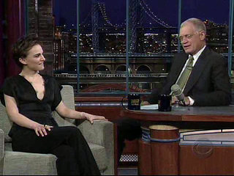
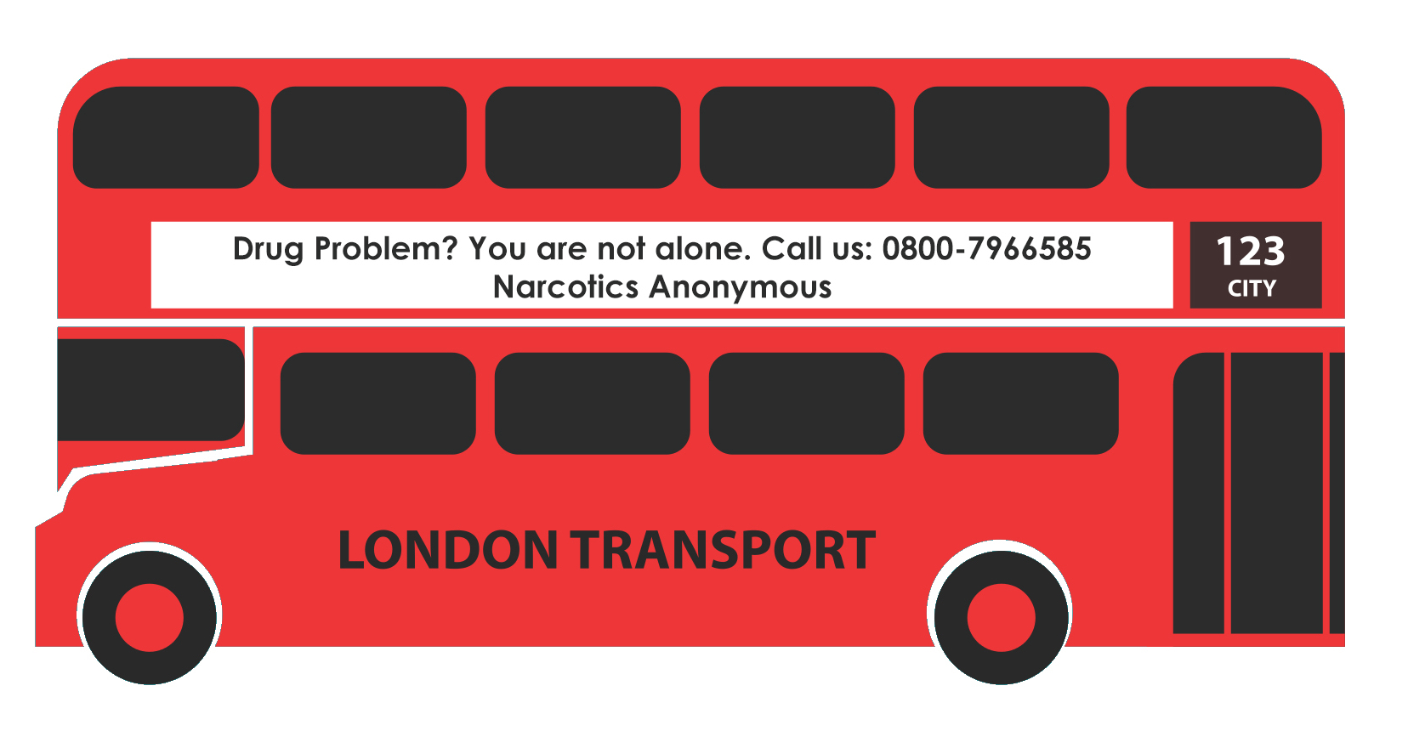
examples Attraction or promotion?
TRADITIONS
Notes:
our message:
any addict can stop using drugs
lose the desire to use
find a new way to live it‘s all we have to give
If you ask younger members where to get information, it‘s social media
DRUG PROBLEM? WE‘VE BEEN THERE.
CALL NARCOTICS ANONYMOUS
WR ARE SAFE. FREE. ANONYMOUS.
WE HELP ADDICTS KEEP THEIR
RECOVERY AFTER REHAB.
MEETINGS DAILY.
DRUG PROBELM? WE CAN HELP.
WE HELP ANY ADDICTS..
IT WORKS. HOW AND WHY?
CALL US OR VISIT OUR WEBSITE
TV/Radio Ankündigungen

Slide 30
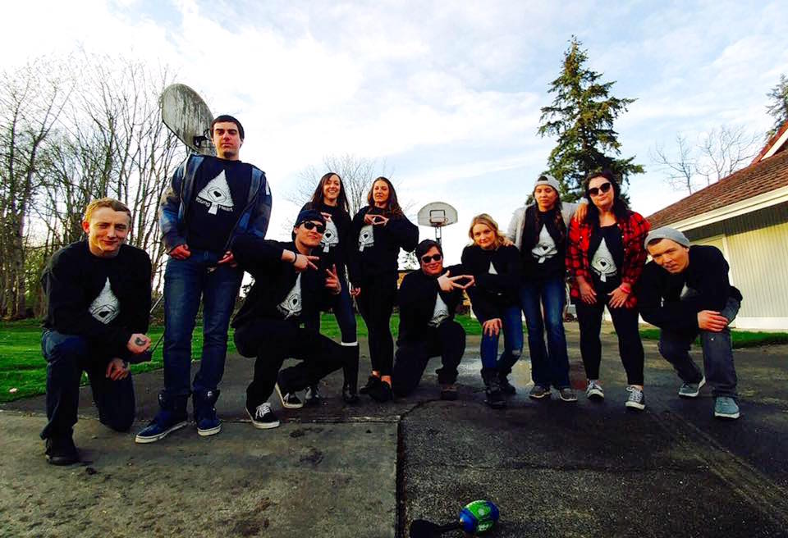
Examples Having fun is Attractive
Meetings Anniversary
Group T-Shirts
Meetings Flyer
Fellowship Activities
TRADITIONS

Slide 31
Cooperation not affiliation
COOPERATION:
Working with public entities to provide them with as much accurate information about us as possible in order for them to better understand NA and to refer individuals to our program.
AFFILIATION:
Affiliation means being joined or connected.
We want to work with other organizations, but we do not want to be merged with them in the mind of prospective members and the public.
If NA becomes strongly identified with any “related facility or outside enterprise”, our primary purpose and independence can become confused with the priorities of others (matters of autonomy).
TRADITIONS
Notes:
Beispiel AA Einladung ins Prison Berlin.

Slide 32
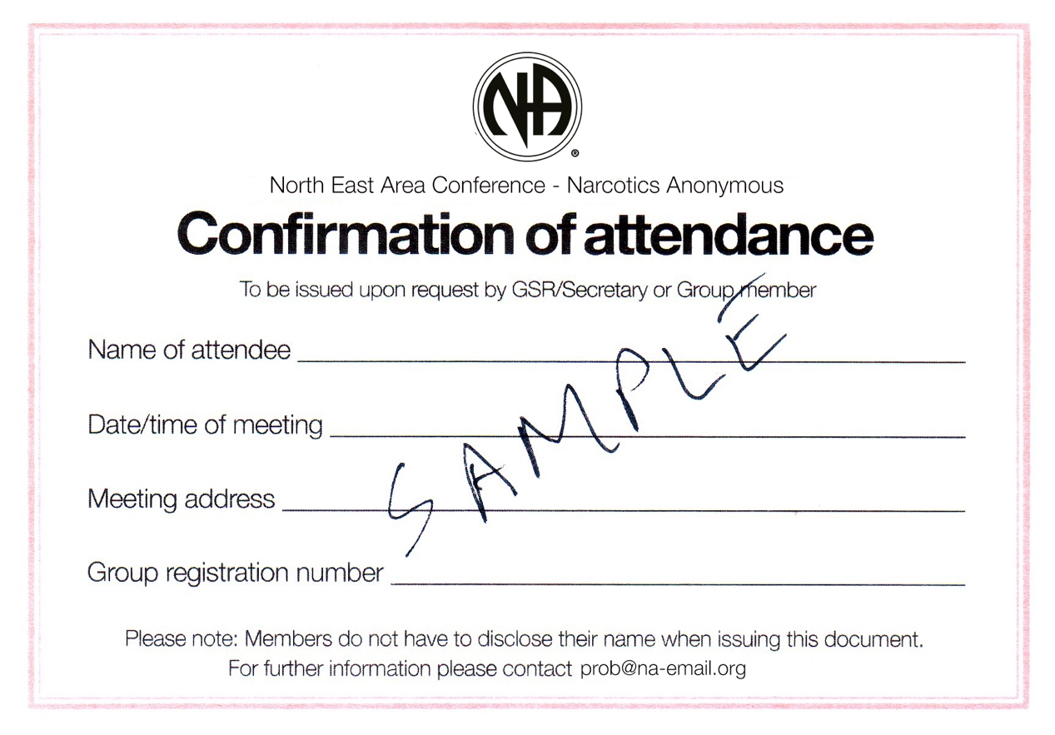
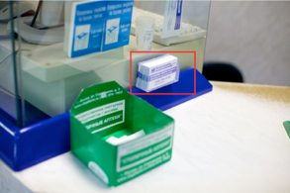
examples Cooperation or affiliation?
Meeting Attendance
Card
TV Spot Emergency Ward
Pharmacy NA Contact Cards
PR at Gay Parade
TRADITIONS
Notes:
violating Trad. 6?
special invitations
Gift Certificates For Life !!!
You made a point. It’s mostly about tracking attendance. In my homegroup, we’ve got a lot of outpatients from treatment centers. We give signature at the beginning of the meeting. And they decide for themselves if they wanna stay or not. I have not seen anybody who left the meeting just right after he has got the signature.
In my homegroup outpatients can ask anyone for a signature, doesn’t have to be the chair.
And yes, ........what’s your problem and how can we help.
Signing an attendance slip doesn't endorse anything. Some people object to it because they think it smacks of affiliation and some object to it because they think it is a kind of surveillance. I always signed them because I figured the addict would be made to suffer through no fault of their own if they didn't collect signatures
My take on court cards is that the member who signs/stamps them does it voluntarily, and as a gesture of cooperation with The officers of the court. This is completely in line with our ‘mutually beneficial relationships ‘ the PR Handbook refers to.
I actually view signing anything as cooperating with the person asking. The court, the treatment program, the mom, the spouse, the employer/professional organization isn't asking us to do it; the person in front of us -- the member or potential member -- is asking.
........what’s your problem and how can we help”
Ask yourself where an addict is better served . In a jail cell or in an NA meeting?

Slide 33
ANONYMITY and the (PR) member
We need always maintain personal anonymity in the public media. At other levels, personal anonymity is a matter of personal choise.
We work as a team to avoid being perceived as a sole representative of NA.
Doing PR demands to disclose personal anonymity for specific purposes. (PR Presentations, Prison, Addiction Conferences)
Anonymity protects us from our own defects of character and makes it impossible for personalities to come before principles.
Anonymity supports our ultimate goal of focusing on our primary purpose instead of our individual concerns. (Principles before personalities)
TRADITIONS
Notes:
If you do PR you might have to disclose your anonymity (Prison, PR Presentations)
Anonymity supports our ultimate goal of focusing on our primary purpose instead of our individual concerns.
The principles contained within our traditions encourage us to humbly join together in hope of forwarding the ideals of our fellowship.
We work together to avoid being perceived as a sole representative of NA
We avoid identifying ourselves as members at the level of press, radio, films, and the internet
We focus on providing everyone an equal opportunity to recover within our fellowship
“Course they did Glynn but i don't mean the general public i mean NA an the meetings an anonymity hardly exists.”

Slide 34
Module 3: THE PR COMMITTEE How to Start Planning Resources

Slide 35
The Pr committee Purpose and responsibility
We clarify what services NA can and cannot provide to the community.
We make NA members more aware of their role in NA’s public image.
We aim for the public to recognize NA as a positive and reliable organization.
We develop valuable relationships with professionals and the general public.
Examples see PR Basics.
THE PR COMMITTEE

Slide 36
small group discussion
These question are just a collection of possible discussions at PR committees.
What is the reputation of NA in this community? How do we serve that reputation, or compromise it?
What organizations do we come in contact with? What part can these contacts play in helping us to carry our message?
What tools do we have to assess the PR needs in our community?
What are some qualifications for PR service beyond the desire to recover?
What different kinds of opportunities to serve are available in this service committee?
TRADITIONS

Slide 37
small group discussion
What kind of support do we provide to new trusted servants?
How do we exercise group conscience in this service?
What tools do we have to assess the PR needs in our community?
How can we help our groups to carry the message when our PR efforts are successful?
What can we do to avoid situations where a member might be seen as a spokesperson for us?
TRADITIONS
Notes:
What does our public image have to do with our primary purpose?
What is the reputation of NA in this community? How do we serve that reputation, or compromise it?
What other organizations do we come in contact? What part can these contacts play in helping us to carry our message?
What are some qualifications for PR service beyond the desire to recover?
What different kinds of opportunities to serve are available in this service committee?
What kind of support do we provide to new trusted servants?
How do we exercise group conscience in this service?
What tools do we have to assess the PR needs in our community?
How can we help our groups to carry the message when our PR efforts are successful?
What can we do to avoid situations where a member might be seen as a spokesperson for us?

Slide 38
The Pr committee Planning
Planning paves the way for that to be a reality and is an important part of providing effective services for NA.
It is much easier to provide effective services if everyone involved understands their tasks, their responsibilities, and the desired end result.
Based on the needs and resources of your area, you can decide which of the following planning methods will work best for you.
Some methods are: - Inventory Local Services - Prioritization - Human Resources - Financial Resources
r?
THE PR COMMITTEE

Slide 39
inventory local services identify strengths and weaknesses
An inventory can help identify what is being done well and what needs improvement.
Most projects depend as much on ideas, information, conscience, and members’ time and willingness as they do on money.
The idea is to identify if there are potential members or people who come into contact with addicts in the community and who need to be reached with our message and where NA may be needed in the community.
This may mean looking where the calls are coming from on the helpline.
better?
THE PR COMMITTEE

Slide 40
prioritization which project seem most needed
Evaluate which projects seem most needed for furthering our Primary Purpose in a local area.
Inviting all members and trusted servants to be part of the prioritizing process helps us to better focus on the broader services needed.
Rather than the desires of individual subcommittees and individual members (to let go of service projects about which they are personally passionate about)
How to prioritize: - Make a list of all desired projects. - Rank the top 3 projects. - Review the areas’ highest priorities. - Look at area financial & human resources.
THE PR COMMITTEE

Slide 41
human resources how to get involved
There is a role for every interested member in their local PR or PI committee.
Identify members who may have skills, but not much experience, and support their involvement in service.
Invite those members who may have been of service in the past to join in current local efforts.
Create a pool of former trusted servants.
Invite them to come and check it out for themselves
Focus on a single project might be easier to involve members who have experience, but lack of time (time expences are forseeable).
Your input, suggestions, feedback, and participation are needed and valued.
THE PR COMMITTEE
Notes:
So how do we make service more attractive and a "Get to Do" attitude rather than a "You're doing it Wrong" environment?
What it takes are people to OWN the process and set the tone for how to mentor and assist willing members in being successful.

Slide 42
financial resources
Examine local financial resources available for prioritized service projects.
One question to consider is if any projects will take funds away from a committee’s routine finances (such as for phonelines).
Project timelines can be created to ensure that financial resources will be available when needed at crucial points during the project.
Our ideal is for contributions to support our services, but many areas turn to fundraising to make service projects possible.?
THE PR COMMITTEE

Slide 43
The Public relation plan identifying our goals
One way to find out which steps re needed is to consider the ideal end result of the goal and then work backwards.
It is important to establish achievable goals that can be realistically accomplished.
Establish the goal of the project based on prioritized needs and available resources of the area.
Plan step-by-step actions or approaches to reach the identified goal.
Use the goal to measure the progress of the project.
(Example: see notes)
THE PR COMMITTEE
Notes:
Goal: Make healthcare workers aware of NA as a credible resource for their clients. Steps to reach the goal: Trusted servants initiate a relationship with local healthcare workers by mailing an introductory letter and an NA information pack. NA members familiar with the field of healthcare give presentations at local healthcare events. Ongoing contact is maintained through written correspondence, email, and/or phone conversations. NA members regularly supply healthcare workers with meeting directories, NA literature, and reliable contact information. Feedback is gathered through an ongoing dialogue or an evaluation form of whether or not NA is an accessible resource. Measure the progress of the project: Review and discuss the feedback from healthcare workers. Evaluate whether or not healthcare workers are aware of NA as a reliable and accessible option for addicts.

Slide 44
Public relation effective services
An area‘s PR goals can have significant impact on the groups. Successful PR projects depend on meaningful group involvement.
Group members should take the time to have step-by-step discussions about the area’s PR efforts.
A committee structure may also use an ad hoc committee or workgroups to get specific projects done.
The use of a coordinators can also help service committees to cooperate more directly with each other.
Use the goal to measure the progress of the project.
Create guidelines (many are available and can be
THE PR COMMITTEE

Slide 45
Module 4: THE PR PRESENTATION Preparation Giving a PR Talk FAQ at PR Presentations

Slide 46
large group discussion
What’s the difference between speaking at an NA Meeting and speaking at a PR presentation?
THE PR PRESENTATION

Slide 47
The PR Presentation giving a pR talk
Being the speaker in an NA meeting:
Speaking directly to addicts, seeking to convey our message of hope through our personal experiences.
Giving a PR talk:
Speaking primarily to those who may influence an addict seeking recovery, convey a clear and attractive picture of what NA is and how it can be a resource for addicts.
Sharing our personal experience is not always appropriate, unless we have been invited for that purpose specifically.
Use audience appropriate language – no NA jargon (in PPT as well)
THE PR PRESENTATION

Slide 48
The PR Presentation Preparation
Determine who is best suited to give the presentation. Match “task-to-talent”.
Invite diverse members (age, gender)
Learn your presentation. Focus on audience, not on your PPT.
Rehearsing is a good thing! Role-play! FAQ’s! Read and re-read.
Dress appropriately to fit the setting. “Business casual” if needed.
Make sure you have the IP’s and other literature appropriate for the presentation. And business cards !
THE PR PRESENTATION

Slide 49
The PR Presentation tips for speaking
Good preparation will help you to overcome tension. Use notes as well.
Many members of the public are more than happy to help us fulfill this purpose, and they appriciate our Goodwill. Relax!
Avoid talking too fast – utilize the powerful speech pause. (We think 600 wpm but we speak 150-225 wpm)
Vary the volume and rate of your speech. A monotone voice is absolutely toxic to keeping the attention of an audience.
Looking at one person – for audience it feels like you are looking at each person (walk closer to the person who ask a question)
When we are exited we forget to breath and tend to be too serious. Find your humor. Use words that evoke emotions. It will help you to get in touch with your audience and with yourself.
THE PR PRESENTATION

Slide 50
The PR Presentation Warm Up (10 Min.)
Give a warm welcome to everyone, introduce presenters and audience members or allow them to introduce themselves.
Refer to the audience and their world
Get to know audience background: “How many are familiar with NA?” “How many have had no exposure to or knowledge of NA?”
Offer a brief outline of the agenda, before you do your PPT, why the presentation is taking place, and what to expect from it.
Let the audience know that there will be time for audience participation (its a term) and questions at the end.
THE PR PRESENTATION

Slide 51
The PR Presentation Information (20 Min.)
What is NA? – A vital resource
Origin of our name – not just opiates
Historical background - local and global – number of countries/meetings
How it works - Membership - Anonymity - Spiritual Approach - NA Recovery Meetings - Sponsorship - NA Step description and Service Opportunities (if appropriate) - NA Conventions (invite the audience)
Statistics / Membership Survey
THE PR PRESENTATION

Slide 52
The PR Presentation Is Na culturally adaptable?
NA is well established in Northern America, Central America, South America, Western Europe, Western Russia, Australia, New Zealand, India and Iran.
New growth: Asia-Pacific, Eastern Europe, Africa.
There are more than 67.000 meetings each week in 132 countries.
NA literature published in over 41 languages.
THE PR PRESENTATION

Slide 53
large group discussion
What has to be considered when members share personal experience at a PR presentation?
TRADITIONS

Slide 54
PersonaL experience at a pr presentation
Sharing our personal experience can be an effective way to make a PR presentation emotional and raise attention of the audience, but it needs to be appropriate and only by invitation.
Personal experience should support PR information. (private issues are not relevant for the audience)
Speaker should be selected, focused on recovery and familiar with PR basics.
Spatial seperation of PR presenter and speaker (audience should see the difference between official NA committee and personal experience)
It’s common to use personal stories in schools (in US).
TRADITIONS

Slide 55
The PR Presentation Cooperating with professionals
NA can assist with welcoming your clients to meetings.
Presentations to professionals and clients.
Printed material, audiovisual, helplines, websites.
Subscription to NA publications (The NA Way Magazine), and literature useful for clients’ introduction to NA.
No charge or fee for your clients to attend NA recovery meetings or for NA presentations.
THE PR PRESENTATION

Slide 56
The PR Presentation Benefits to the client
NA assists with transition back into the community.
NA can support clients while they are still in treatment.
NA provides a (peer based) support network and social community.
NA provides drug-free role model reinforcement. Often clients have had minimal exposure to drug-free living. Members of NA provide that role model in their work and home environment.
NA provides a drug-free social environment through aftermeetings, conventions, dances, picnics. (New Friendships) conventions, dances, picnics.
THE PR PRESENTATION
Notes:
Members can meet clients at meetings or provide rides to meetings. Often members will invite newer members to social gatherings such as dances or invite them out for refreshments following a meeting.
If clients have phone privileges, they can contact NA members and begin building their peer support network.
Members maintain their support network through sponsorship, meeting attendance, and using a telephone network of recovering friends. This extends to the social community as members join together for movies, theatre, sports events, etc.

Slide 57
The PR Presentation Benefits to the professional
Immediate access for clients.
Valuable adjunct to treatment.
Research indicates: improves retention
Immediate access to aftercare support
Research material: NAWS suggests studies conducted by J. F. Kelly, R. Stout, W. Zywaik (2006) and K. Humphries (2005) as two possible choices for you.
NA membership survey evaluated by an outside company.
THE PR PRESENTATION

Slide 58
The PR Presentation Afterward
Onsite
Collect the sign-in sheet, and business cards.
Don’t runaway – get engaged in conversations
Use feedback to improve for next time
If your audience has ideas or opinions about challenges to adaptability and growth in your community, consider your response to those ideas.
Survey the audience.
After the event
Write thank-you notes to all who attended.
At regularly scheduled intervals, follow up with all who attended.
THE PR PRESENTATION

Slide 59
small group role play I.
Presentation (30 minutes) Break the room into three sections. For this exercise we will focus on three presentation scenarios: 1. Treatment Centers/Hospitals (Addiction Professionals) 2. NGOs/government institutions (Politicians) 3. Corrections/Legal (Parol Officers, ...)
Assign one of the presentations to each section.
Each presentation will be 5 minutes, with an additional 5 minutes for questions.
Ask members to take a few moments to choose who will present to the entire group. Members who do not present are the professionals who will ask questions.
Encourage the groups to use the packet to prepare the presentation and to use the FAQ’s to provide questions. Keep points made earlier in mind with presentations.
Remind entire group that it takes courage to present to peers – we will applaud their efforts.
Remind entire group that only members from each section will ask questions.
THE PR PRESENTATION

Slide 60
Large group role play II.
Presentation (30 minutes)
Ask for volunteer presenters; otherwise choose a section to start
Monitor time and move along if they run over
After each presentation role-play, CLAP and praise their efforts
Wrap-Up (5 minutes)
Recap session, including some of the high points from the presentations.
Challenge members to share how they might utilize or put into action what they heard here today. Hear from a few members.
Invite members to share some of the things they learned here, try these ideas in their communities, and share their experience.
THE PR PRESENTATION

Slide 61
Roundtable Discussions questions for professionals
What can NA do to become a better-known resource for addicts who desire recovery?
What specific information could NA provide to make us more accessible?
What do you perceive as the shortcomings of NA in the community?
How can NA improve the way it is perceived in your field?
What do you think we are doing right? How can we do better?
PR session with professional at ECCNA 31 in Birmingham 2015.
THE PR PRESENTATION

Slide 62
The PR Presentation Frequently asked questions
What is the difference between AA and NA? AA helped start NA in 1953 by giving NA’s founding members permission to adapt their traditions and steps. The primary difference between the two programs is that AA’s focus is alcohol and alcoholism, whereas NA’s focus is recovery from addiction. In NA we believe that use of drugs, including alcohol, is but a symptom of the disease of addiction.
How can I find NA meetings in my neighborhood or in various countries around the world? The easiest way to find NA meetings is by visiting NA World Services website, www.na.org. Since our members provide the data for the meeting locator, we cannot guarantee the information is completely accurate (some meetings may have changed locations, for example). Contacting local area and regional helplines or websites (also listed at www.na.org) will often provide more accurate meeting information (Have a local meeting directory with you during the presentation.).
NA is only for junkies and crackheads. When NA first started, it is possible that the majority of our members used heroin. Today, as indicated in our Membership Survey, our members use a variety of drugs, including alcohol. Interestingly, 78% of those surveyed list alcohol as one of the drugs used on a regular basis. This survey also provides information about employment status, occupation, gender, and age. Our basic tenet about addiction is that it is a disease and not related to a specific substance.
THE PR PRESENTATION
Notes:
GLOSSARY:
Addict:
An addict is someone who suffers from the disease of addiction. Please pay attention to describing the difference: between drug addict / drug dependant, as opposed to having the disease of addiction. Addiction is not only about using drugs, but includes a physical, mental and spiritual living problem that we have; („... our ultimate problem – ourselves ...“) The disease of addiction isn‘t only about using drugs; it can be present even when we are not using drugs.
2. Drugs A mind or mood altering substance. Also see definition of: Using.
3. Using Using: Presently taking mind or altering drugs, as in „... desire to stop using“, for the purpose of escape or recreation. The opposite of „abstinence“(see #10)
4. Progressive Illness Progression, in this context, means: getting worse. When one uses, the disease will progress in a negative and destructive way:“...the disease is chronic, progressive and fatal...“ But in a different context the meaning can change: „...progressive recovery process...“ Here the meaning is of course positive.

Slide 63
The PR Presentation Frequently asked questions
Is someone who is still using drugs welcome to attend NA meetings? Yes, they are more than welcome to attend meetings. Many of our members actually came to meetings while still using drugs and are now drug-free and recovering today. Often, if a member is still using, he or she will be asked to refrain from speaking during a meeting. Instead, these addicts are encouraged to speak with members during break or before or after the meeting.
There will be people present at NA meetings who have not yet achieved stable abstinence.
What happens at an NA meeting? An NA meeting is where two or more addicts gather for the purpose of recovery from the disease of addiction. Members offer each other peer support by sharing experiences about how they manage life situations without returning to using drugs. Some meetings have speakers who share their experience with getting and staying clean, while others have structured formats that focus on NA literature (our Basic Text, informational pamphlets, or our Just for Today daily meditation book). All meetings focus on recovery and supporting each other in recovery. Here are some other things that can occur at an NA meeting: During the course of a meeting, a basket is passed for our members to contribute money to support the cost of the meeting facility and other services. One of our traditions speaks to our self-support through our own contributions. Meetings often open and close with the Serenity Prayer or some quote from NA literature. [In some communities this may require some explanation. The word “prayer” could be troublesome.] Some meetings also provide keytags to recognize days, months, and years of continuous abstinence from drugs.
THE PR PRESENTATION

Slide 64
The PR Presentation Frequently asked questions
I reffered someone to NA who was taking medication, and NA members said they were not clean. Would you explain what you mean? NA is a program of complete abstinence, and members refer to time (days, weeks, months, years) without using drugs as “cleantime.” Since Narcotics Anonymous is an abstinence-based recovery program, persons who are taking drug replacement medication are not considered drug-free. These persons are encouraged and welcome to attend NA meetings; however, they are asked to listen rather than speak at meetings, and it is suggested they talk to members on a break, or before or after a meeting. Meetings that follow this format do so to preserve the atmosphere of recovery. For members who have a need to take prescribed medication for medical or mental health issues, we suggest reading the booklet In Times of Illness. This piece provides helpful, experience-based information regarding medication and illness, and outlines the idea that the decision to take medication is left to the member, physician, and sponsor. This pamphlet was written to help members who have achieved total abstinence from drugs and are faced with a need to take medication. Unfortunately, our members often voice their own opinions about the use of medication even though NA has no opinion. Although this may be a disconcerting issue for professionals, it can be equally as confusing to many members. Typically, members of NA make a distinction between drug replacement medication and medication that a person needs to take once they are completely abstinent from drugs.
NA meetings are based on monologues and lack the possibility to ask questions in order to get some helpful response.
THE PR PRESENTATION

Slide 65
The PR Presentation Frequently asked questions
NA is not religious, but you talk about God? And why do you talk about Higher Power at the first place? The NA program is based on a set of spiritual principles that are not associated with a particular religion. Although our steps call for finding and believing in a “power greater than oneself,” this is a personal decision for each and every member to make. Members choose their own “power greater than themselves.” Members’ beliefs range from nature to organized religion, from no belief that a power exists, to belief in the power of inanimate objects such as rocks. Members are free to choose a belief that works for them personally, and there is no opposition to anyone’s choice within the fellowship. We perceive this to be a strength of our program — the unconditional freedom members have with choosing their own personal belief — and in NA meetings one can hear members state that this was an attractive and safe aspect of the fellowship. NA doesn’t oppose or endorse any religion. Experience of our members has shown that the spiritual principles work for all members, from the devoutly religious to the atheist and agnostic.
In meetings it often says „Addicts are powerless“? Don‘t they need power? (even members have huge difficulties with this question. The answers are often quite odd or not reaseanable at all)
My clients would be offended by the profanity at NA meetings. (well, this statement appears every now and then)
What’s your opinion on the current administration’s drug policy? Narcotics Anonymous has no opinion on the current administration’s drug policy as this is outside our scope. We offer no opinion on any outside issues, including drug policy, so as not to divert us from our primary focus — one addict helping another to recover from the disease of addiction.
THE PR PRESENTATION

Slide 66
The PR Presentation Frequently asked questions
What support does NA have for adolescents? Adolescents are welcome at all NA meetings. If there are meetings in a local NA community specifically designated for young people, the meeting schedule will identify those meetings as such. Although any NA member is welcome at any NA meeting, specially designated youth meetings can help younger addicts find their peers.
What resources do you have for single parents? Are children welcome at meetings? Most groups welcome children who are behaved and under the supervision of a parent. Sometimes a group will offer babysitting services for its members. Contact the local NA helpline for additional information or look for meetings in the local NA meeting directory that indicate childcare or that the group is children-friendly.
What an Addict Can Expect at NA Meetings? Many addicts attending their first NA meeting may feel that they are visiting “another planet.” NA meetings have their own language and culture. Language often heard in meetings includes the words clean, Twelve Steps, Higher Power, and sponsor. Cultural norms within NA meetings may include greeting addicts with welcoming hugs, handing out keytags for various lengths of cleantime, reciting common readings, first-nameonly introductions, and lots of clapping. These examples are a small sample of the distinctive language and culture within NA, and these customs can be overwhelming to new attendees.
THE PR PRESENTATION

Slide 67
The PR Presentation Frequently asked questions
How many NA members have been incarcerated? How many NA members have been convicted of sex-related crimes? We do not collect that type of data.
What’s your opinion on methadone? In general, we cannot assess anyone’s desire to abstain from drugs, and NA has no opinion on drug replacement therapies used by professionals in the management of addiction. NA is a program of total abstinence. This provides the foundation for recovery from drug use and for further personal growth. Narcotics Anonymous has only one membership requirement: a desire to stop using drugs. Drug addicts who are participating in drug replacement therapies are welcome in NA meetings. Most meetings ask that people under the influence of any mind- or mood- altering substances listen (rather than speak) during the meeting, and speak to members on an individual basis before and after the meeting. Meetings that follow this practice do so to preserve an atmosphere of recovery in the meeting.
Do you think complete abstinence is needed? We think complete abstinence is needed in order to recover. Therapy while active using doesn’t really make sense.
THE PR PRESENTATION

Slide 68
The PR Presentation Frequently asked questions
CLEAN Clean in NA typically refers to being free of all drugs, or abstinent. However, an addict who is not clean is free to attend meetings; we hope through attendance at meetings addicts will gain a sense of belonging and identification with other recovering addicts. Abstinence and membership are not synonymous terms. Membership is based on a desire to stop using, not abstinence itself. “Our program of recovery begins with abstinence from all drugs, including alcohol. Sometimes people come to NA meetings while still using drugs, detoxing from drugs, or on drug replacement therapy. Regardless of what you may be taking when you first come to NA, you are welcome.” (Informational Pamphlet #29, An Introduction to NA Meetings) SPONSOR A sponsor is an individual recovering member who serves as a guide or mentor to new persons. A sponsor can share experience on how to live drug-free and face life on life’s terms without using drugs. A sponsor also helps members to work the Twelve Steps of Narcotics Anonymous, the basis for recovery in NA. KEYTAGS Keytags are given to addicts for lengths of cleantime. Cleantime is a significant accomplishment within NA and is recognized at NA meetings. One keytag—the “welcome to NA” keytag—is given to any addict attending their first meeting regardless of whether they are clean or not.
THE PR PRESENTATION

Slide 69
The PR Presentation Frequently asked questions
PRAYER Another practice is meetings usually opening and closing with a prayer. This is not intended to connote any religiosity. Each person is free to choose his or her own Higher Power, which some equate to a force greater than themselves helping them to remain drug-free. This is a personal decision made by each addict.
FORMAT Meeting formats vary from meeting to meeting. Some of the more common formats are topic/ discussion meetings and speaker meetings. NA also holds open meetings, where anyone is welcome to attend; however, only addicts share at these meetings. Closed meetings are for addicts only.
THE PR PRESENTATION

Slide 70
Thank you
© Copyright 2019 by Narcotics Anonymous
European Delegates Meeting
www.edmna.org
fdc@edmna.org

