Slide 1
12 Concepts

Slide 2
12 CONCEPTS FOR NA SERVICE
Early 1950s, the 12 Steps for our personal recovery.
The 12 Traditions are designed to guide the NA groups and meet its needs.
In Tradition 9, the groups are encouraged to create a service structure.
The 12 Traditions were never intended to provide our service structure with the directions it needs to serve by.
The Twelve Concepts summarize a vast amount of experience in NA service, experience we would all do well to consider and apply wherever appropriate.

Slide 3
1st Concept
To fulfill our fellowship’s primary purpose, the NA groups have joined
together to create a structure which develops, coordinates, and maintains
services on behalf of NA as a whole.
Responsibility
The primary responsibility of an NA group is to conduct its recovery meetings. The service structure ensures that other services are fulfilled effectively without distracting the groups from their own primary purpose.

Slide 4
2nd Concept
The final responsibility and authority for NA services rests with the NA groups.
Authority
The service structure must always look to the groups for support and direction. The groups have final responsibility for and authority over the service structure they have created.

Slide 5
3rd Concept
The NA groups delegate to the service structure the authority necessary
to fulfill the responsibilities assigned to it.
Delegation
Delegated practical authority is not a blank check, the groups still bear
final authority. To make this work, we must carefully select trusted servants.

Slide 6
4th Concept
Effective leadership is highly valued in Narcotics Anonymous.
Leadership qualities should be carefully considered when selecting trusted
servants.
Leadership
Leaders help us organize, focus our energy and resources, and act in unity.
Without good leaders it will be challenging, if not impossible, to achieve
these goals.

Slide 7
5th Concept
For each responsibility assigned to the service structure,
a single point of decision and accountability should be clearly defined.
Accountability
We need to eliminate confusion about who has authority to do what. Whoever is given the authority will be held accountable for the fulfillment of that task.

Slide 8
6th Concept
Group conscience is the spiritual means by which a loving God influence
our decisions.
Spiritual Guidance
We need to bring the spiritual awakening of the Twelve Steps to bear in
making service-related decisions. It is not, however, merely a euphemism
for “voting” and is not itself the NA decision-making process.

Slide 9
7th Concept
All members of a service body bear substantial responsibility for that
body's decisions and should be allowed to fully participate in its decision
making processes.
Participation
NA service is a team effort. The full participation of each member of the
team is of great value as we seek to express the conscience of the whole.

Slide 10
8th Concept
Our service structure depends on the integrity and effectiveness of our
communications.
Communication
Regular communication is essential to the integrity and effectiveness of our services themselves.

Slide 11
9th Concept
All elements of our service structure have the responsibility to
carefully consider all viewpoints in their decision-making processes.
Open-mindedness
To check judgment, to guard against hasty or misinformed decisions,
and to invite the sharing of new ideas, our services must consider all
viewpoints when making plans. This is essential to the development
of a fair, wise, balanced group conscience.

Slide 12
10th Concept
Any member of a service body can petition that body for the redress of a
personal grievance, without fear of reprisal.
Fairness
The Tenth Concept encourages us to treat each other with respect and
provides us with a means of making amends when we wrong others.

Slide 13
11th Concept
NA funds are to be used to further our primary purpose, and must be
managed responsibly.
Finances
Responsibility
The sole absolute priority for the use of NA funds: to carry the message.
The importance of that priority calls for total fiscal accountability. Direct
contributions to each level of service help us to enhance accountability.

Slide 14
12th Concept
In keeping with the spiritual nature of Narcotics Anonymous, our structure should always be one of service, never of government.
Service, Not Government
Within the context of the Twelve Concepts, as a body, this concept serves much the same function as Tradition Twelve in the context of the traditions. It brings our consideration of concepts for NA service back to the
spiritual root of selfless service.

Slide 15
The 12 Concepts
provide our service structure with guiding principles to serve the groups.
They are not the law for NA service.
They are valid only to the extent that they prove helpful.

Slide 16
Brainstorming Questions
Does NA have leaders?
What are some of the skills and personal traits we seek when selecting trusted servants? What is the real foundation of NA leadership?
“Effective NA leadership knows not only how to serve, but when it will serve best to step aside and allow others to take over.” What is your experience in regards rotation of leadership.

Slide 17
Brainstorming Questions
How could clearly defining specific responsibilities help us get our services moving ahead at full speed?
Do you have clearly defined guidelines for each service task? If yes, how do you apply them?

Slide 18
Brainstorming Questions
How could a lack of regular communication undermine those concepts, and the integrity and effectiveness of our service structure?
How has this effective communication - or lack of it- affected your group? The service structure?

Slide 19
Brainstorming Questions
Is it important to make sure all viewpoints are considered when making service decisions?
Do NA services make the effort they should seek out new, different viewpoints?

Slide 20
The full fruit of a labour of love lives in the harvest and that always come in its right season.
From the preface of the Basic Text.

Slide 21
For Your Attention
Many Thanks

Slide 22
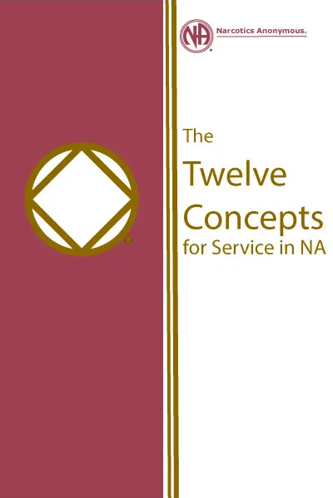
Thank you for your ongoing support.
Your FD Team.
www.edmna.org
www.na.org
fd@edmna.org

