Slide 1
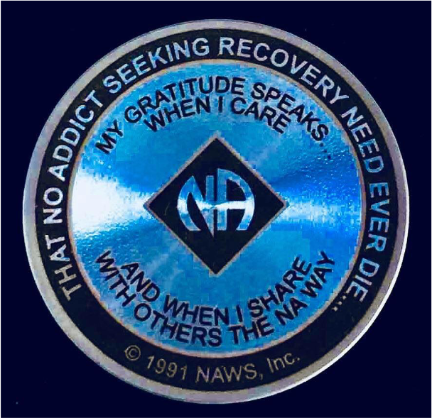
EUROPEAN DELEGATES MEETING (EDM)
Title
EDM FD COMMITTEE
Building strong, reliable services
Cairo Friday 9th September 2022

Slide 2
Elements of an effective service structure
NA VISION

Slide 3
Trusting the process
When we trust the process, we are free to participate in it. We are safe to act in unity, speak our conscience from a place of love, and hear the voice of a Higher Power.
Trust in the process and in our higher power help us sort out what we want, what we need and what we can afford”
Our Guiding principles: tradition 2

Slide 4
Accountability/responsibilty
The practice of being responsible to those we serve teaches us to surrender to the will of the group and have patience with the process. These skills serve us in our personal recovery and in our ongoing development as a fellowship.
Guiding principles: the spirit of our traditions.
Tradition 9. Page 176

Slide 5
Concept 2: Authority / responsibility
The final authority and responsibility for NA services rests with the NA groups
Twelve concepts for NA service

Slide 6
Concept 3: Delegation of authority
“The NA groups delegate to the service structure the authority it needs to fulfill the responsibility assigned to it.”
Twelve concepts for NA service

Slide 7
Question for discussion.
How can we find balance between the delegation of authority to our service structure and between the final responsibility of the groups over our services?

Slide 8
Sustainability/Being realistic
When we ask our service bodies to do something, … we need to think about sustainability: will our community be willing to support this over time?
We discuss whether the level of commitment is realistic for us as well as other obligation that already exist.
Guiding principles: the spirit of our traditions.
Tradition 7.

Slide 9
Financial accountability
“We protect (ourselves) and our trusted servants when we prevent large sums of money from being the responsibility of any one person……this practice also reduces the risk or temptation that can come with large sums on hand.”
Guiding principles: the spirit of our traditions.
Tradition 7. Page 127.

Slide 10
SMALL GROUP DISCUSSION
Question 1
What is the importance of carefully choosing our trusted servants to build strong reliable services?

Slide 11
SMALL GROUP DISCUSSION
Question 2
How do we know if our service efforts are building up or burning out?

Slide 12
SMALL GROUP DISCUSSION
Question 3
How can we tell that our service efforts are paying off?

Slide 13
SMALL GROUP DISCUSSION
Question 4
At the level of NA funds what practices can we follow to prevent temptation leading to the waste of fund?

Slide 14
SMALL GROUP DISCUSSION
Question 5
Do we develop our services according to the needs of our groups?

Slide 15
SMALL GROUP DISCUSSION
Question 6
What can we do to make sure our demands from our service structure are realistic and that our groups will support these efforts?

Slide 16
Small group discussions
Question 1:
What is the importance of carefully choosing our trusted servants to build strong reliable services?
Question 2:
How do we know if our service efforts are building up or burning out?
Question 3:
How can we tell that our service efforts are paying off?
Question 4:
At the level of NA funds what practices can we follow to prevent temptation leading to the waste of fund?
Question 5:
Do we develop our services according to the needs of our groups
Question 6:
What can we do to make sure our demands from our service structure are realistic and that our groups will support these efforts.

Slide 17
Building strong reliable services
It takes time to build services that we can sustain and that will sustain us. It is our responsibility to keep an eye on either our efforts in service are building up or burning out. The investment of time and energy that is called for building solid, reliable services pays off in solid, reliable NA communities.
Guiding principles: the spirit of our traditions.
Tradition 7. Page 130.

Slide 18
WRAP UP
Thank you for your active participation
Please feel free to contact us
fd@edmna.org / vicefd@edmna.org
fd.secretary@edmna.org
YOUR EDM FD TEAM
Ayman/Alessandro/Jadwiga
www.edmna.org

