Slide 1
Building Strong
Homegroups

Slide 2
BUILDING STRONG HOME GROUPS
EDM FD workshop
based on WSC material

Slide 3
Building Strong Home Groups What, How and Why
This workshop is meant to help NA members strengthen their home groups. Use it in your group or area business meetings to find ways to grow and improve.
You can schedule an extra time for this workshop on your group or area business meeting or have a get-together on a separate day.
To make the process quick and smooth, print and hand out copies of this sheet in advance and try to get as many group members as possible involved. It is also important to announce that this workshop will be held on your group or in your area.

Slide 4
Building Strong Home Groups Goals of the session
Stress the importance of a strong home group as the foundation of NA.
Introduce the Building Strong Home Groups worksheet.
Identify and prioritize actions that can be taken to strengthen home groups.
Involve people into actions.

Slide 5
Building Strong Home Groups Icebreaking
Challenge each table to practice the small group discussion process by brainstorming a name for their table, like a group name.
What positive message do they want to convey with their name?
Give them 5 minutes to agree on a name.
Quickly go around the room, hearing the new table names.
You may want to include card stock for tables to make group name signs.

Slide 6
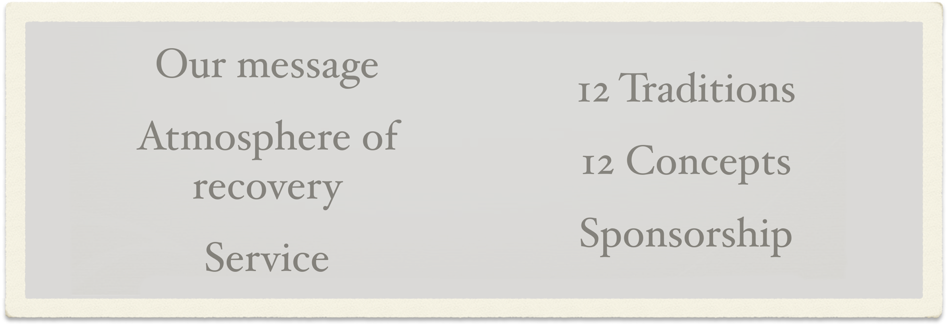
Building Strong Home Groups Step 1
Identify Areas for Group Improvement
Members can choose one or two items below the group can improve, before or during the business meeting. Address the top issues, one at a time.

Slide 7
Building Strong Home Groups Step 2
State the Issues
The group should briefly discuss what needs to be improved in each area they chose, one at a time. Remember, keep it simple!
Don’t get too wrapped in the problem; move into the solution.

Slide 8
Building Strong Home Groups Step 3
Brainstorm Solutions
As a group, discuss solution ideas. Remember, there are no bad ideas and there is no need to debate. One idea that won’t work might lead to another that will.
Focus on ways to make progress; don’t worry about being perfect.
Small improvements are better than no improvements.

Slide 9
Building Strong Home Groups Step 4
Choose the Solutions
Choose the ideas that most members agree on. If needed, this can be done by a simple vote.

Slide 10
Building Strong Home Groups Step 5
Make Decision(s)
From the brainstorming, look for simple, practical
actions the group can take to implement the solutions.
Be specific about who will carry out the action,
and how it should be done.

Slide 11
Building Strong Home Groups Step 5
Call for action
Ask people who wants to take some action and to improve the situation. Let them go out and be recognized as leaders by the rest of participants.
Ask them how, when and what can they do to change the situation.

Slide 12
Building Strong Home Groups Step 5
Let'em speak
Recollect the efforts we take to create an atmosphere of recovery and the unconditional love that we strive for in NA.
Let members give input about main areas that home groups can be strong: ideals, practices, and roles.

Slide 13
WWW.EDMNA.ORG
© Copyright 2012 by Narcotics Anonymous European Delegates Meeting
contact@edmna.org

